Slide 1
Preparing People for the Economic Challenges Ahead
Ganesh Natarajan

Slide 2
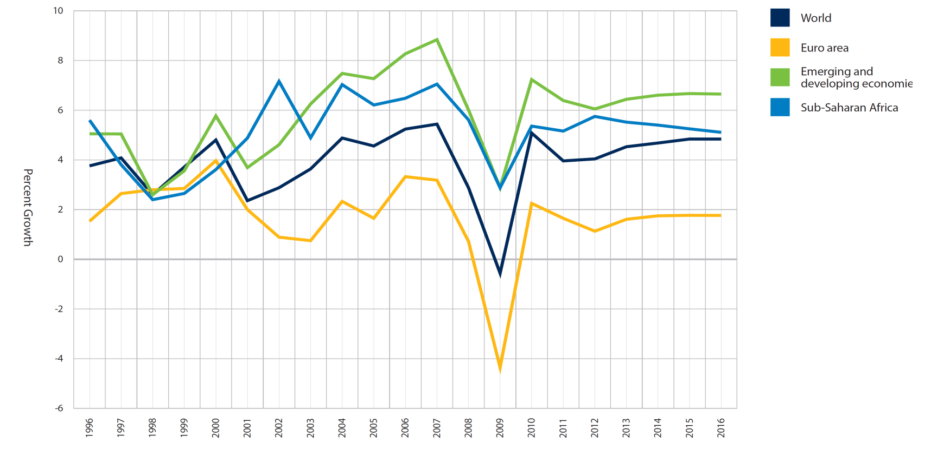
World Economy – GDP Growth
Recent events indicate high volatility in Financial Markets
Public Debt Crisis
World’s largest economies are facing challenges due to high levels of sovereign debt
Fragile Economic Outlook
2012 will see industrial economies struggling to avoid recession.
Instability of Financial Markets
A need of a globally acceptable financial regulatory system
The Rollback of Globalization
2012 to see increasing levels of civil unrest, calls for protectionism and other anti-globalization moves
Source: IMF & WEF 2011.
Notes:
Public Debt Crises.
The world’s largest economies are now facing the kind of sovereign debt crises once seen only in the worst cases in the developing world. This is occurring at a time when many countries are facing slow or negative growth and significant levels of unemployment. Resolving these issues without dismantling government services or further stifling economic growth will challenge many governments in the West.
Fragile Economic Outlook.
2012 will see industrial economies struggling to avoid recession. The shift in global trade patterns is shaping the economic outlook. As its major markets suffer, China is seeing a perceptible slowing of its growth. Unemployment will continue to be a key challenge in many countries.
Instability of Financial Markets.
Increasing instability of global financial systems is likely due to the lack of a sound and globally accepted financial regulatory system; a failure in confidence in market participants or facilitators, and speculation. The result will be unsustainable financial and fiscal policies across different nations and resulting uncertainties in the global economic recovery. Many countries will be searching for a new equilibrium among the different sectors of the economy, new societal balance and new models of governance.
The Rollback of Globalization.
Each of these trends will reduce social surpluses – the ability of governments to provide extensive services, employment and social protection. The social costs of economic dislocation will bring people into the streets. 2012 is likely to see increasing levels of civil unrest, calls for protectionism and other anti-globalization rhetoric as governments struggle to cope with multiplying problems with fewer resources.

Slide 3
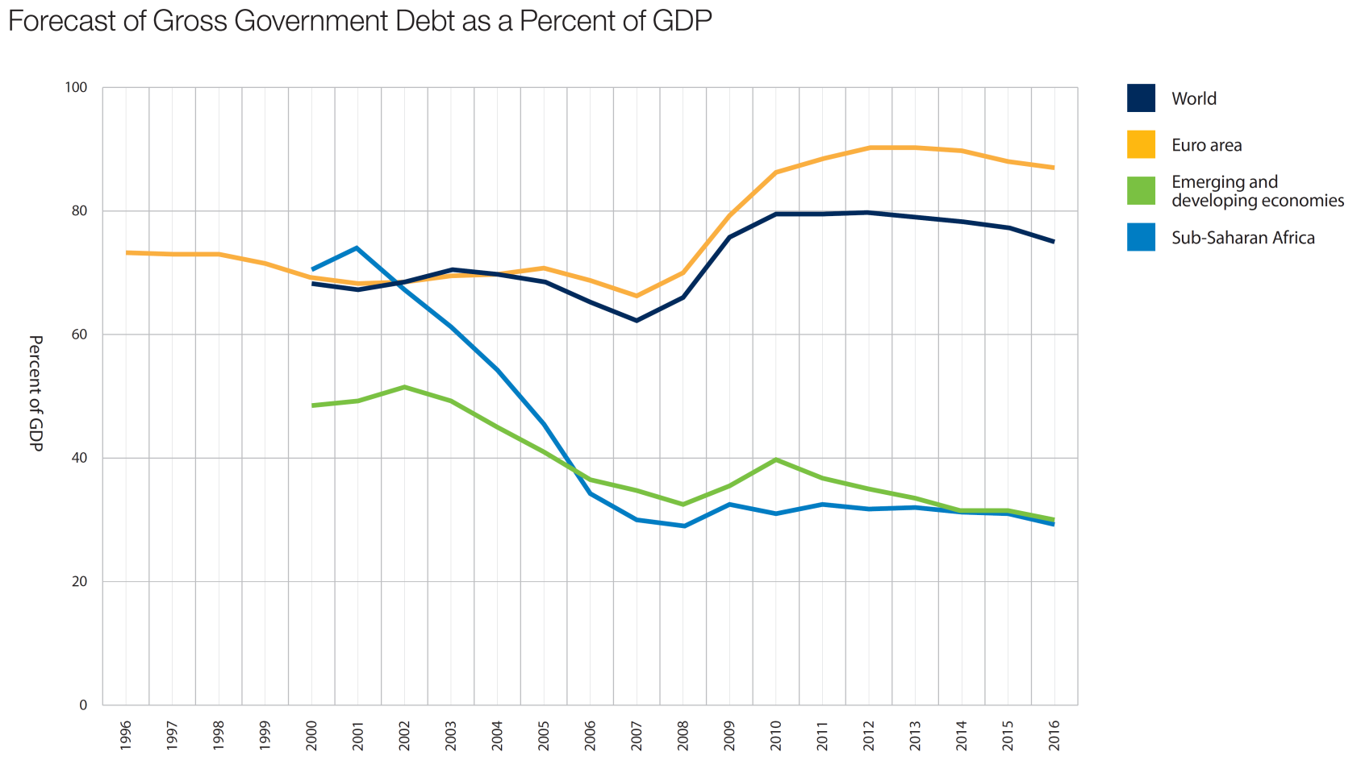
Expected recovery slower in developed countries
Global Recovery dragged down by developed Countries due to their Sovereign Debt Crisis
Developing nations show faster recovery compared to developed ones.
Developing nations lead the World Growth but will also moderate soon.
Source: IMF & WEF 2011.

Slide 4
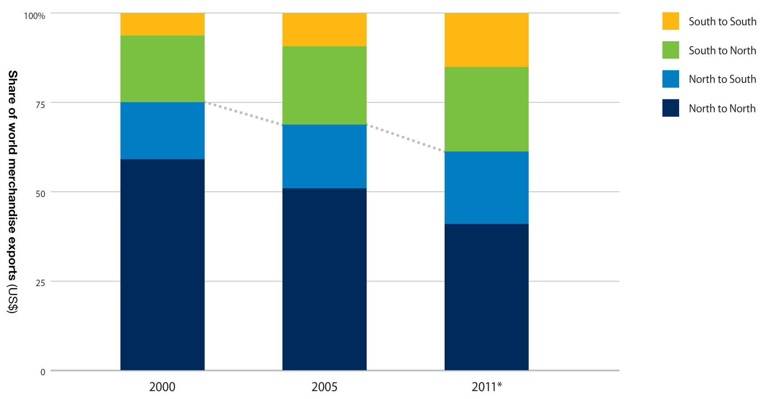
Share Of Global Exports
40% of Exports now originate from Developing and Emerging Markets
Power Sharing Between North & South
Increasing economic and political power sharing between North and South will be manifest in the continued weakening of the UN system and the rise of regionalism.
Accelerated Transfer of Influence
The shift from traditional state-centric institutions to coalitions of the willing and non-state actors.
Shift of Power
There will be a shift from large, expensive, institutional power to small, low-cost, unpredictable and grassroots sources of power, such as the Arab Spring, the Indignados and the Occupy movements.
Source: IMF & WEF 2011.
Notes:
Power Sharing Between North and South.
Increasing economic and political power sharing between North and South will be manifest in the continued weakening of the UN system and the rise of regionalism.
Accelerated Transfer of Influence.
The shift from traditional state-centric institutions to coalitions of the willing and non-state actors will be manifested in diplomacy and action by networks of actors and regional organizations.
Shift of Power.
There will be a shift from large, expensive, institutional power to small, low-cost, unpredictable and grassroots sources of power, such as the
Arab Spring, the Indignados and the Occupy movements.

Slide 5
Impact on IT-BPO Industry
Slowdown in discretionary spends
Currency Exchange to positively impact revenues and margins
Back-office support and other non-discretionary spends to remain constant or increase
Continued inflation and margin pressure in Indian companies

Slide 6
Changes in Business models
More Managed Services
Fixed price contract revenues
1
Shift towards managed services model,
risk sharing
2
From FTE based to outcome based;
pay per use model, CAPEX to OPEX
Innovation and transformation
Patents granted to top 5 Indian IT companies
3
IP Led innovation
4
Innovation through process re-engineering
Global delivery
Cross border and domestic M&A deals
5
Globally dispersed footprints, blurred corporate
boundaries and decoupled value chains
6
Customer intimacy, geo political diversity
Service delivery around new tech
Leading Indian companies offering cloud solutions
7
Everything as a service model, platforms
8
Develop applications around cloud and
platform based solutions
Source: NASSCOM Strategic Review 2011

Slide 7
Internal re-engineering
Customer centricity
YoY Growth of Business Development
1
Vertical focused business units to better service
clients
2
Enhance client relations from vendor to
partnerships, augment sales teams
Push towards non-linear growth
Revenue and Employee growth CAGR FY07-11E
3
Development of IP, investment in labs
4
Alliances and partnerships, M&A
Talent re-engineering
% of fresh hires with Non technical background in IT services
5
Sustained investments in training
6
Leveraging alternative talent streams
Continued operational excellence
7
SG&A as a % of total revenues
Reduction in expenses even as
business development increases
8
Increase fresher hiring, expansion to
Tier II/III locations

Slide 8
Imperatives for Organizations
Deriving Employee Engagement
Employee Development Plan
Managing Manager and Employee Generation Gap
Aligning HR with Business

Slide 9
Understanding HR with Business
Linking HR practices to differentiators
HR alignment with internal & external stakeholders
Notes:
HR alignment with internal and external stakeholders
Linking HR practices to differentiators
Flow of people – into, through, up and out of the organization
Flow of performance management – linking people to work through standards and measures, rewards and feedback
Flow of information – keeps employees aware of the organization, what is happening and why, and shares collective knowledge
Flow of work – who does work, how and where work is done

Slide 10
Understanding the ‘Millenials’ Workforce
Factors driving Behaviour of India’s Gen Y :
Exposure to global events and Western Counterparts
Huge excitement on India’s economic resurgence
Entrepreneurial and business savvy
Easily accept diversity
Notes:
Factors driving Behavior of India’s Gen Y :
Exposure to global events and Western Counterparts
Huge excitement on India’s economic resurgence
Entrepreneurial and business savvy
Easily accept diversity

Slide 11
How to manage the Gen Y
Provide real leadership
Challenge your employees
Foster connect with co-workers
Make the workplace fun and enjoyable
Notes:
Provide real leadership: Need leaders with honesty and integrity- need role models.
Challenge your employees: Wants learning opportunities-look for growth, development, career path.
Foster family relationship with workers: Wants to work with people they click with - like being friends with coworkers.
Make the workplace fun and enjoyable: A little humor, a bit of silliness, even a little irreverence will make the work environment more attractive for them.
Show respect to everyone: Expects their approaches and ideas to be treated with respect, even though they are new and inexperienced. Assign projects to teams of people who are measured as a group for specific goals. They love praise as the highest sign of respect .
Be flexible: A rigid schedule is a sure-fire deterrent. Work life balance is important for them: flexible work weeks, flexible start times, and work at home opportunities are very popular with them !

Slide 12
Zensar’s 5F culture
Culture
Friendly
Flexible
Fast
Fun
Focus
Associate Relations
Open Culture: Durbar-e-Khaas
Communication Channels – EBM
Madat Online
PMP
Values
Flexi – Timing
Time-Off-Scheme
Redeployment
Quarterly Events
Vividha
Floor Games
Responsiveness
SLA’s

Slide 13
Three step approach by Zensar
Managerial Connect
To drive engagement locally
Direct connect with Top Management
Vision Community
Driving Ownership
iZen

Slide 14
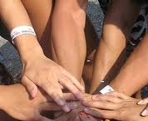
Employee Engagement
A personal connection employees have with their job, organization, manager, or team that motivates them to excel at their work
SAY
STAY
STRIVE
Speak positively about the organization
Desire to be a member of the organization
Go beyond what is minimally required

Slide 15
Driving Engagement through Managers
Manager
Relationship
Trust in Senior Leadership
Development of opportunities
Pride in Organization
Utilization of strengths
Employee
Engagement
Connection to Organization’s success
Co-Worker
Relationships
Discretionary Effort
Job Satisfaction

Slide 16
Thank You!
ganeshn@zensar.com

